Slide 1
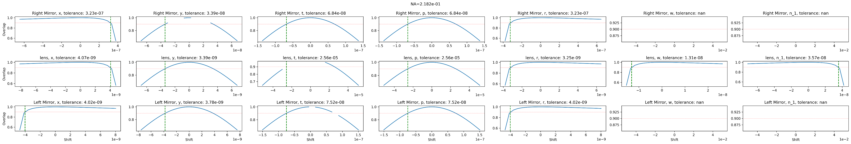
Overlap as a function of perturbation (blue graps)
There is a row for every element (mirror/lens) in the system.
There is a column for every geometrical parameter of the elements.
The x-axis stands for possible perturbation in the relevant element and parameter.
For example, the x-axis in the first row, which represents the right mirror, and the fifth column, which represents the mirror's radius, represent different changes to the mirror's radius (in meters).
The y-axis represents the integral overlap between the original system and the system after the perturbation of the given parameter.
The vertical green line marks the shift where the overlap crosses 0.9.
The horizontal red line marks the 0.9 value.

Slide 2
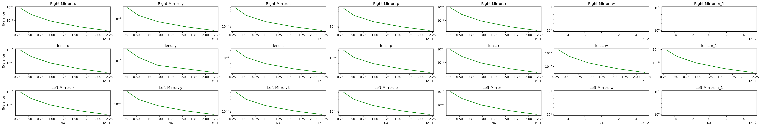
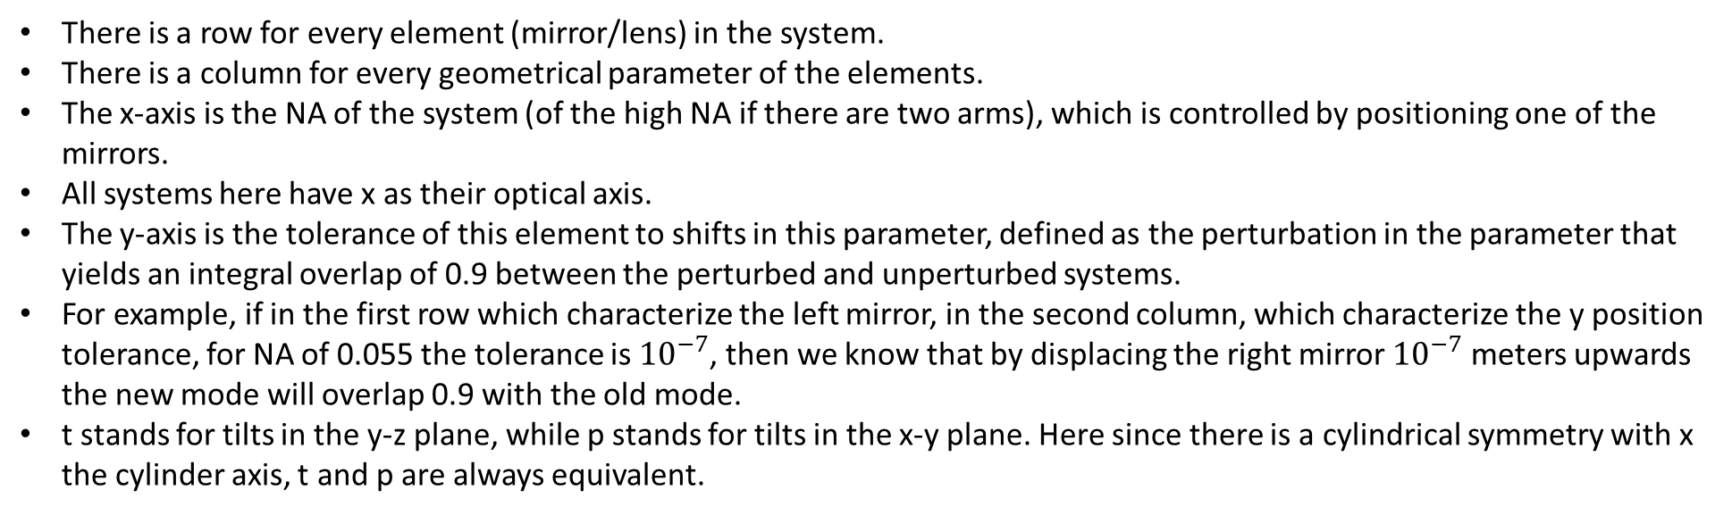
Tolerance as a function NA graph (green graphs)
There is a row for every element (mirror/lens) in the system.
There is a column for every geometrical parameter of the elements.
The x-axis is the NA of the system (of the high NA if there are two arms), which is controlled by positioning one of the mirrors.
All systems here have x as their optical axis.
The y-axis is the tolerance of this element to shifts in this parameter, defined as the perturbation in the parameter that yields an integral overlap of 0.9 between the perturbed and unperturbed systems.
For example, if in the first row which characterize the left mirror, in the second column, which characterize the y position tolerance, for NA of 0.055 the tolerance is ${10}^{−7}$, then we know that by displacing the right mirror ${10}^{−7}$ meters upwards the new mode will overlap 0.9 with the old mode.
t stands for tilts in the y-z plane, while p stands for tilts in the x-y plane. Here since there is a cylindrical symmetry with x the cylinder axis, t and p are always equivalent.

Slide 3
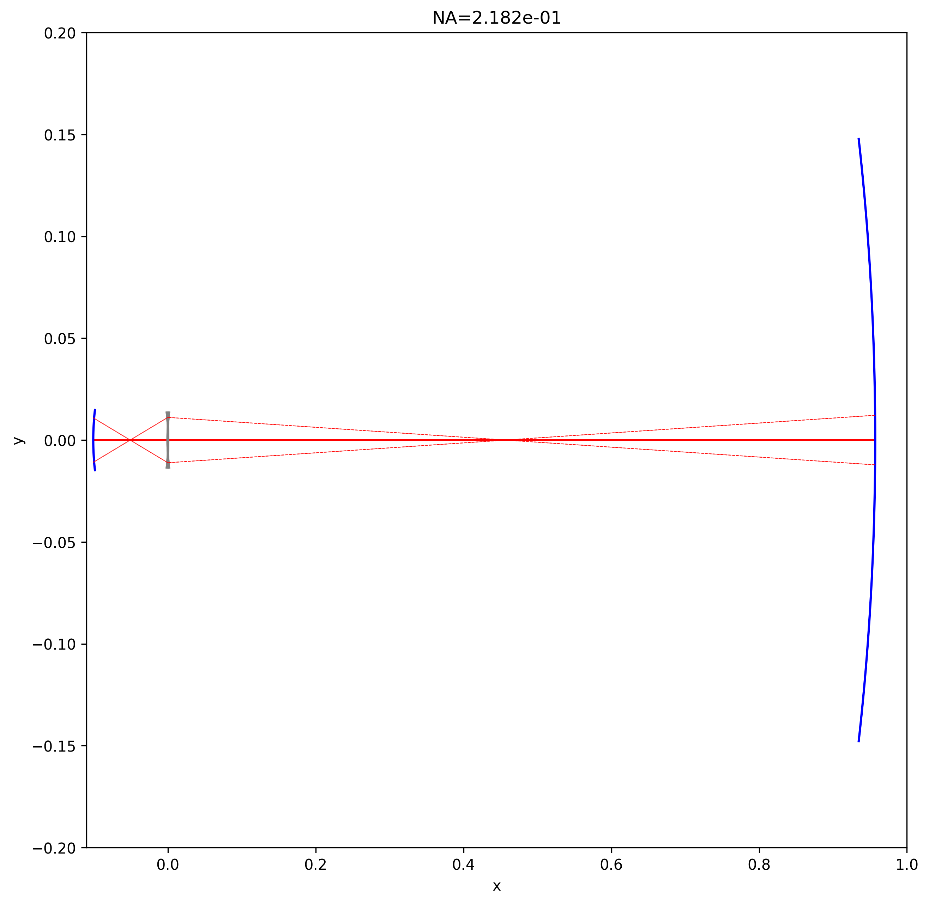
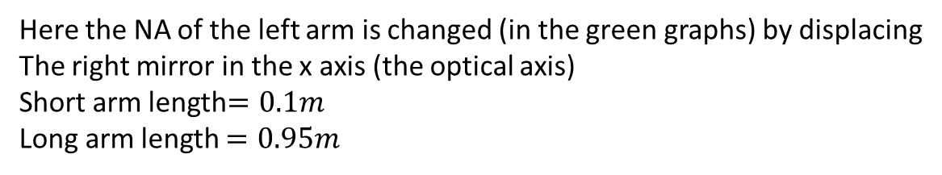
Here the NA of the left arm is changed (in the green graphs) by displacing
The right mirror in the x axis (the optical axis)
Short arm length$=0.1m$
Long arm length $=0.95m$

Slide 4
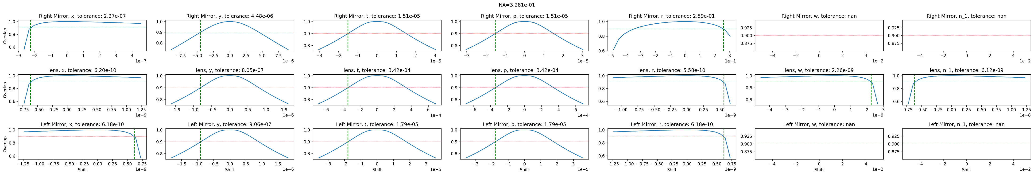
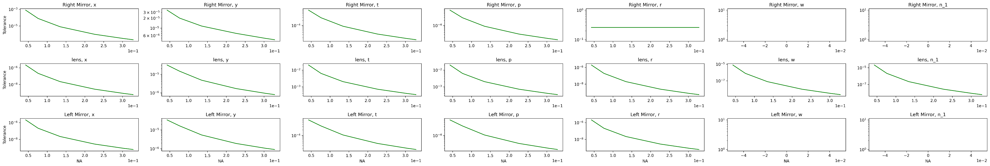
Here the NA of the left arm is changed (in the green graphs) by displacing
The left mirror in the x axis (the optical axis)

Slide 5
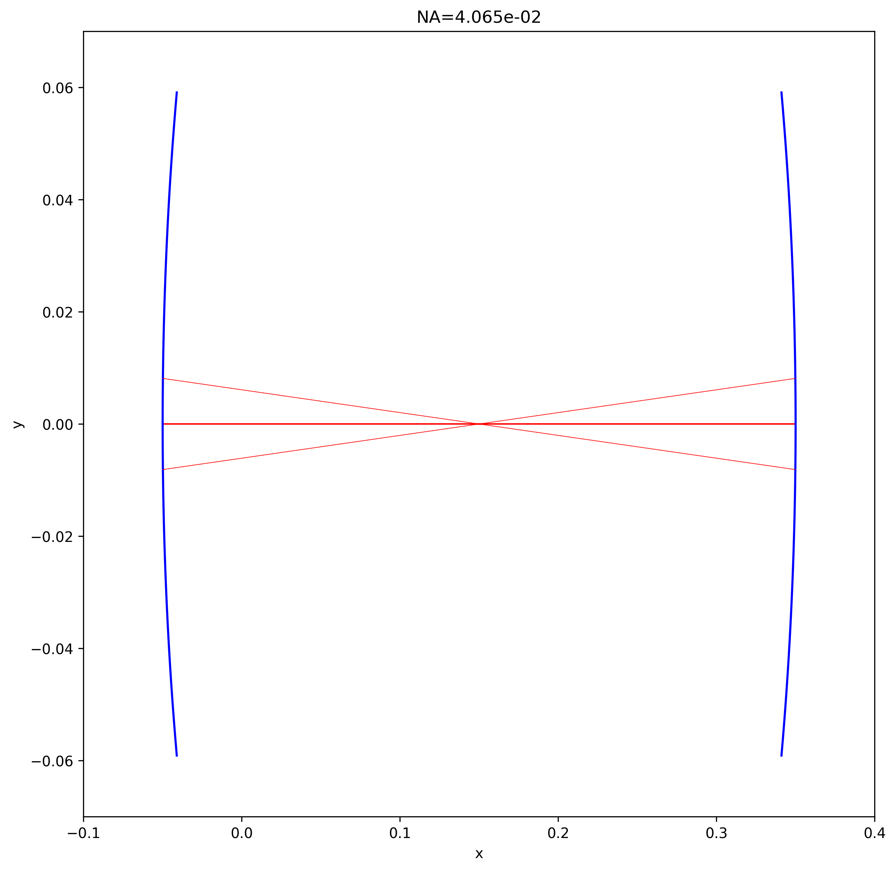
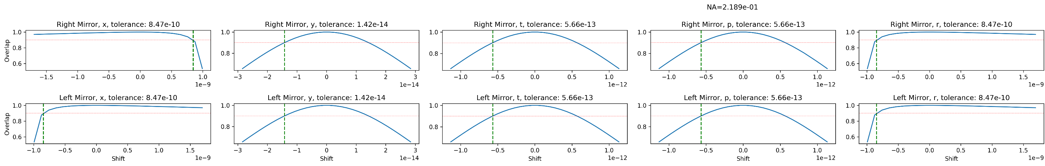
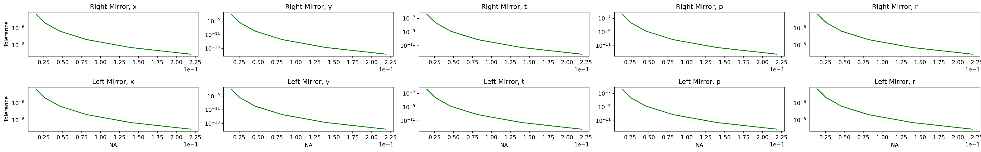
Here the NA of the is changed (in the green graphs) by displacing
The right mirror in the x axis (the optical axis).

Slide 6
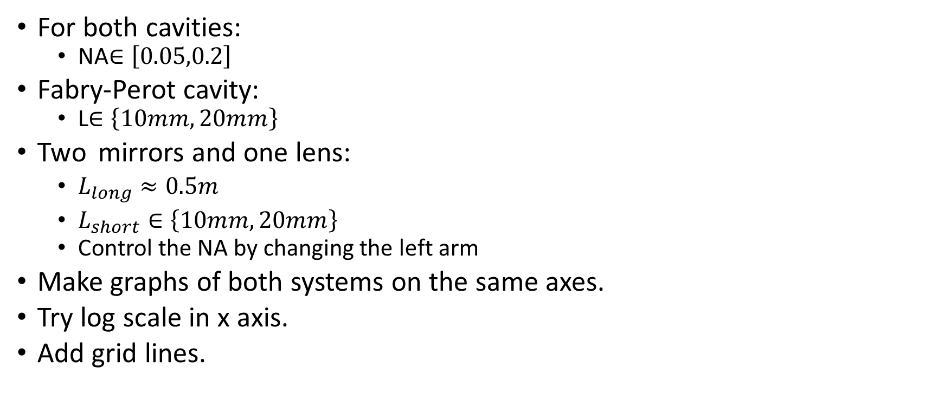
For both cavities:
NA$∈\left[0.05,0.2\right]$
Fabry-Perot cavity:
L$∈\left\{10mm,20mm\right\}$
Two mirrors and one lens:
$L_{long}≈0.5m$
$L_{short}∈\left\{10mm,20mm\right\}$
Control the NA by changing the left arm
Make graphs of both systems on the same axes.
Try log scale in x axis.
Add grid lines.

